Slide 1
Flow Analysis
1-30 meeting

Slide 2
Question List
What is the real-time number?
To know the crowded density. Can develop an app to show density.
What is the inflow and outflow rate?
For vendors to prepare.
What is the average meal time?
???? no use
How many visitors per hour?
Utilization, for buildings to save energy.
What is the proportion of students from library to canteen?
To promote competition, improve service.

Slide 3
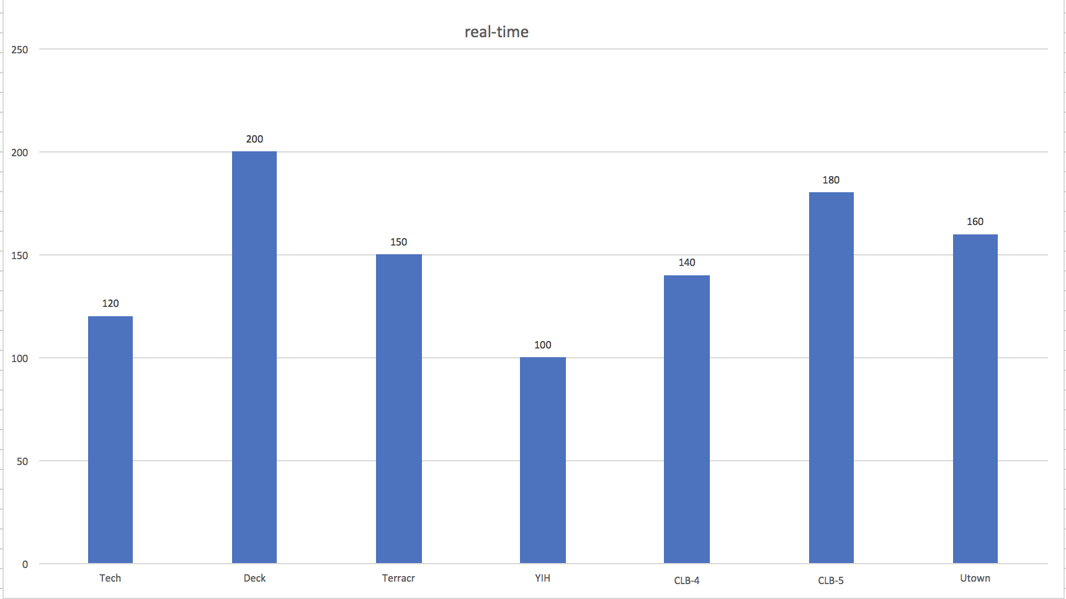
What is the real-time number?

Slide 4
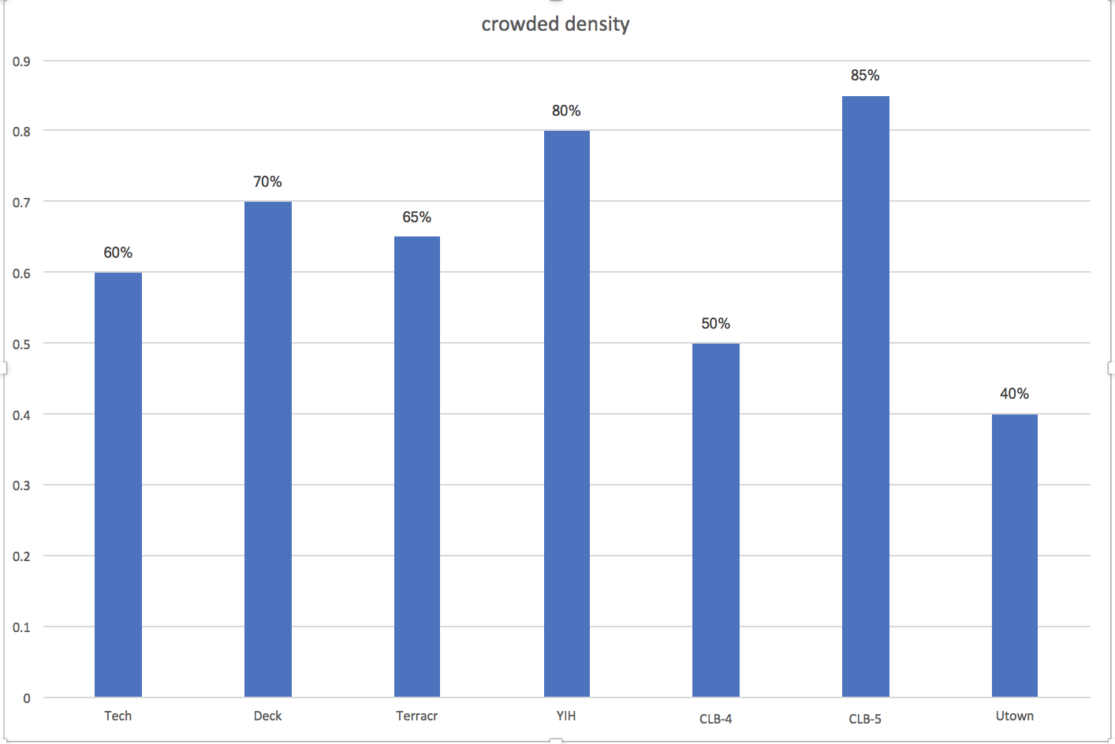

Slide 5
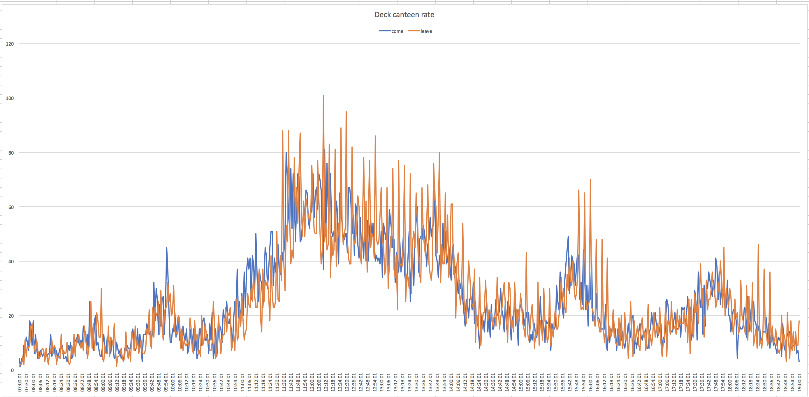
What is the inflow and outflow rate?
2018-01-17 Deck canteen

Slide 6
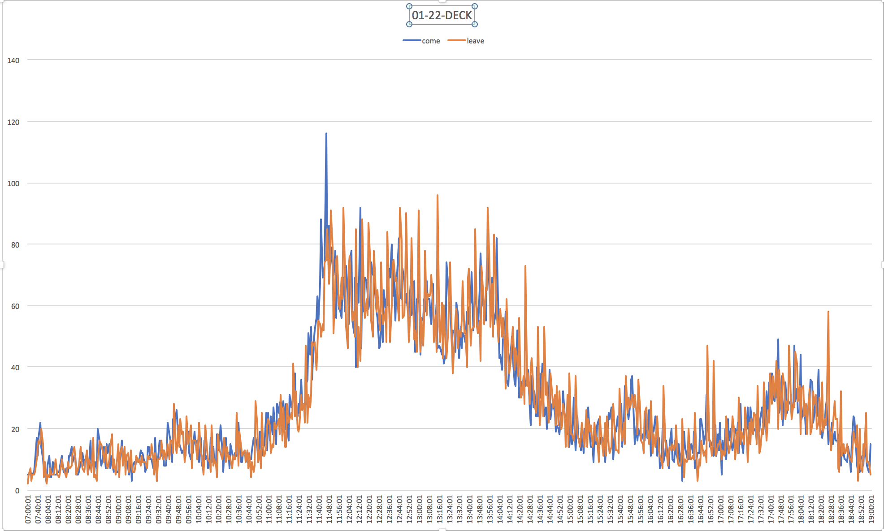

Slide 7
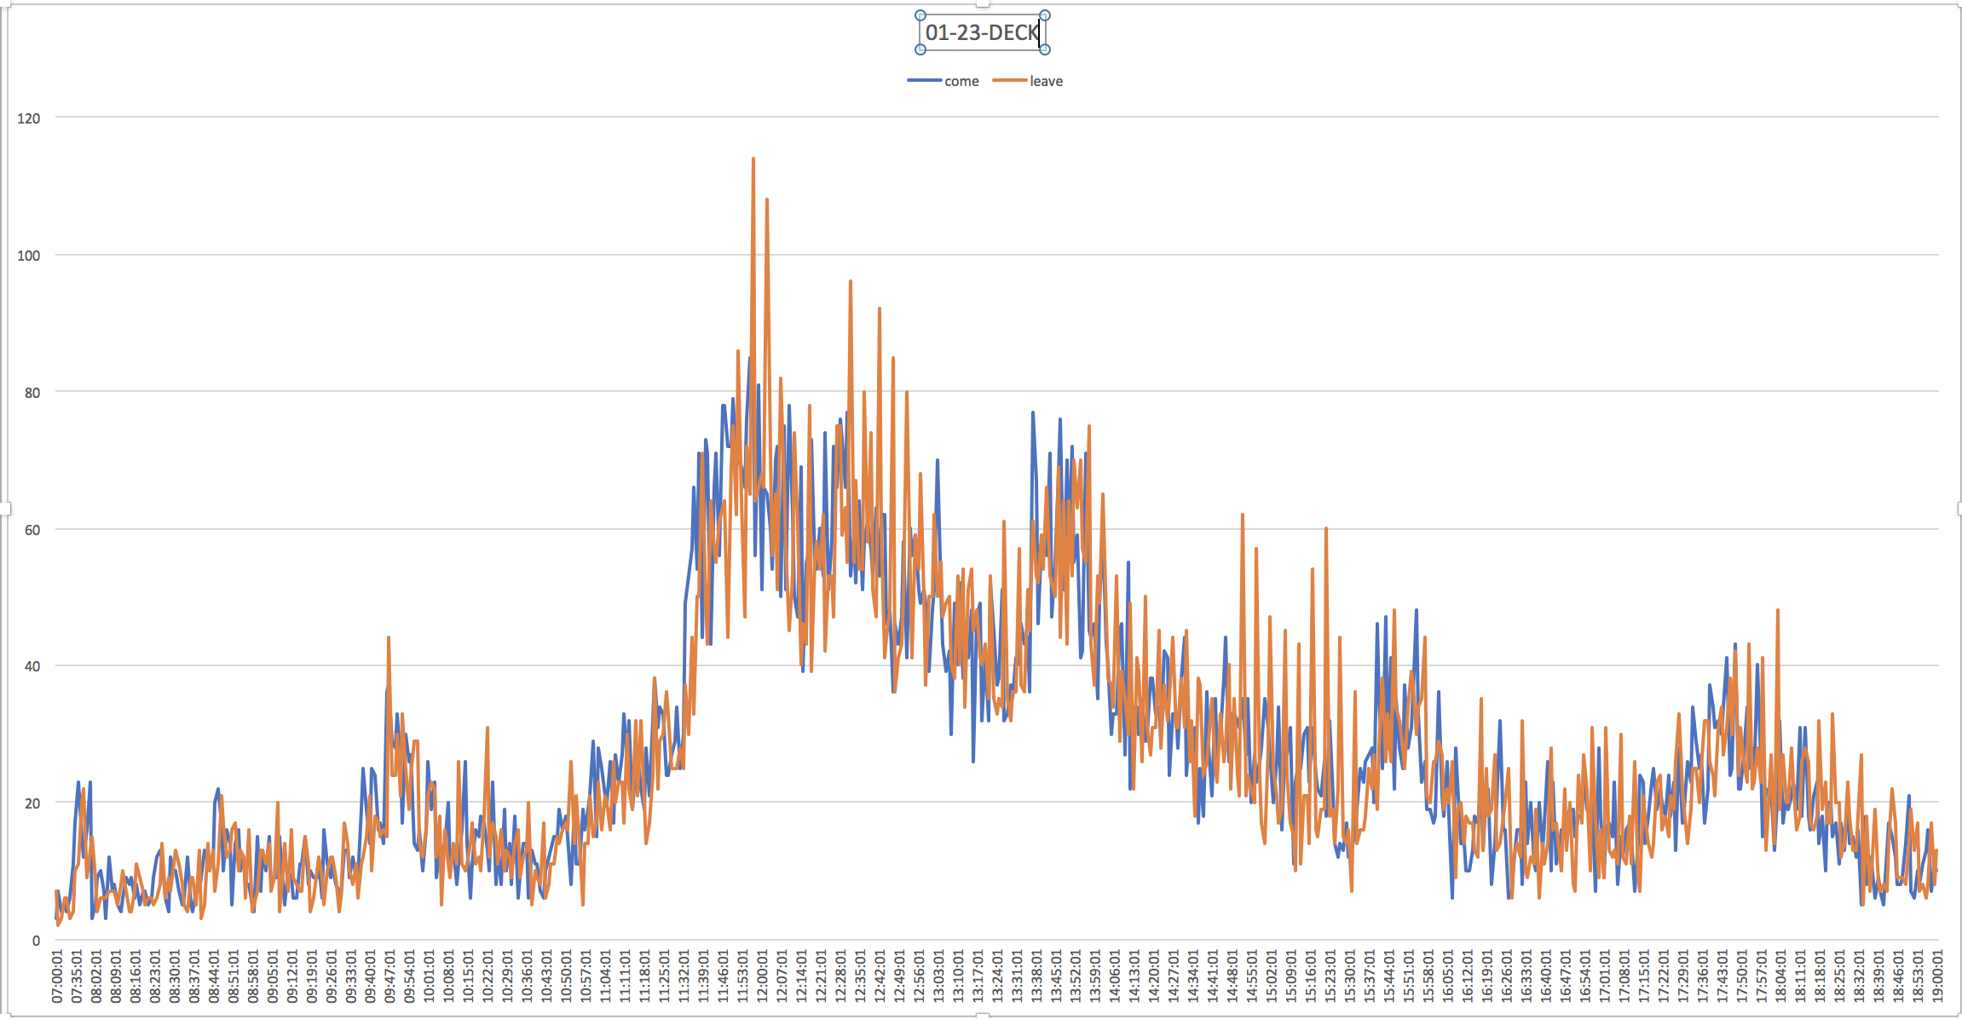

Slide 8
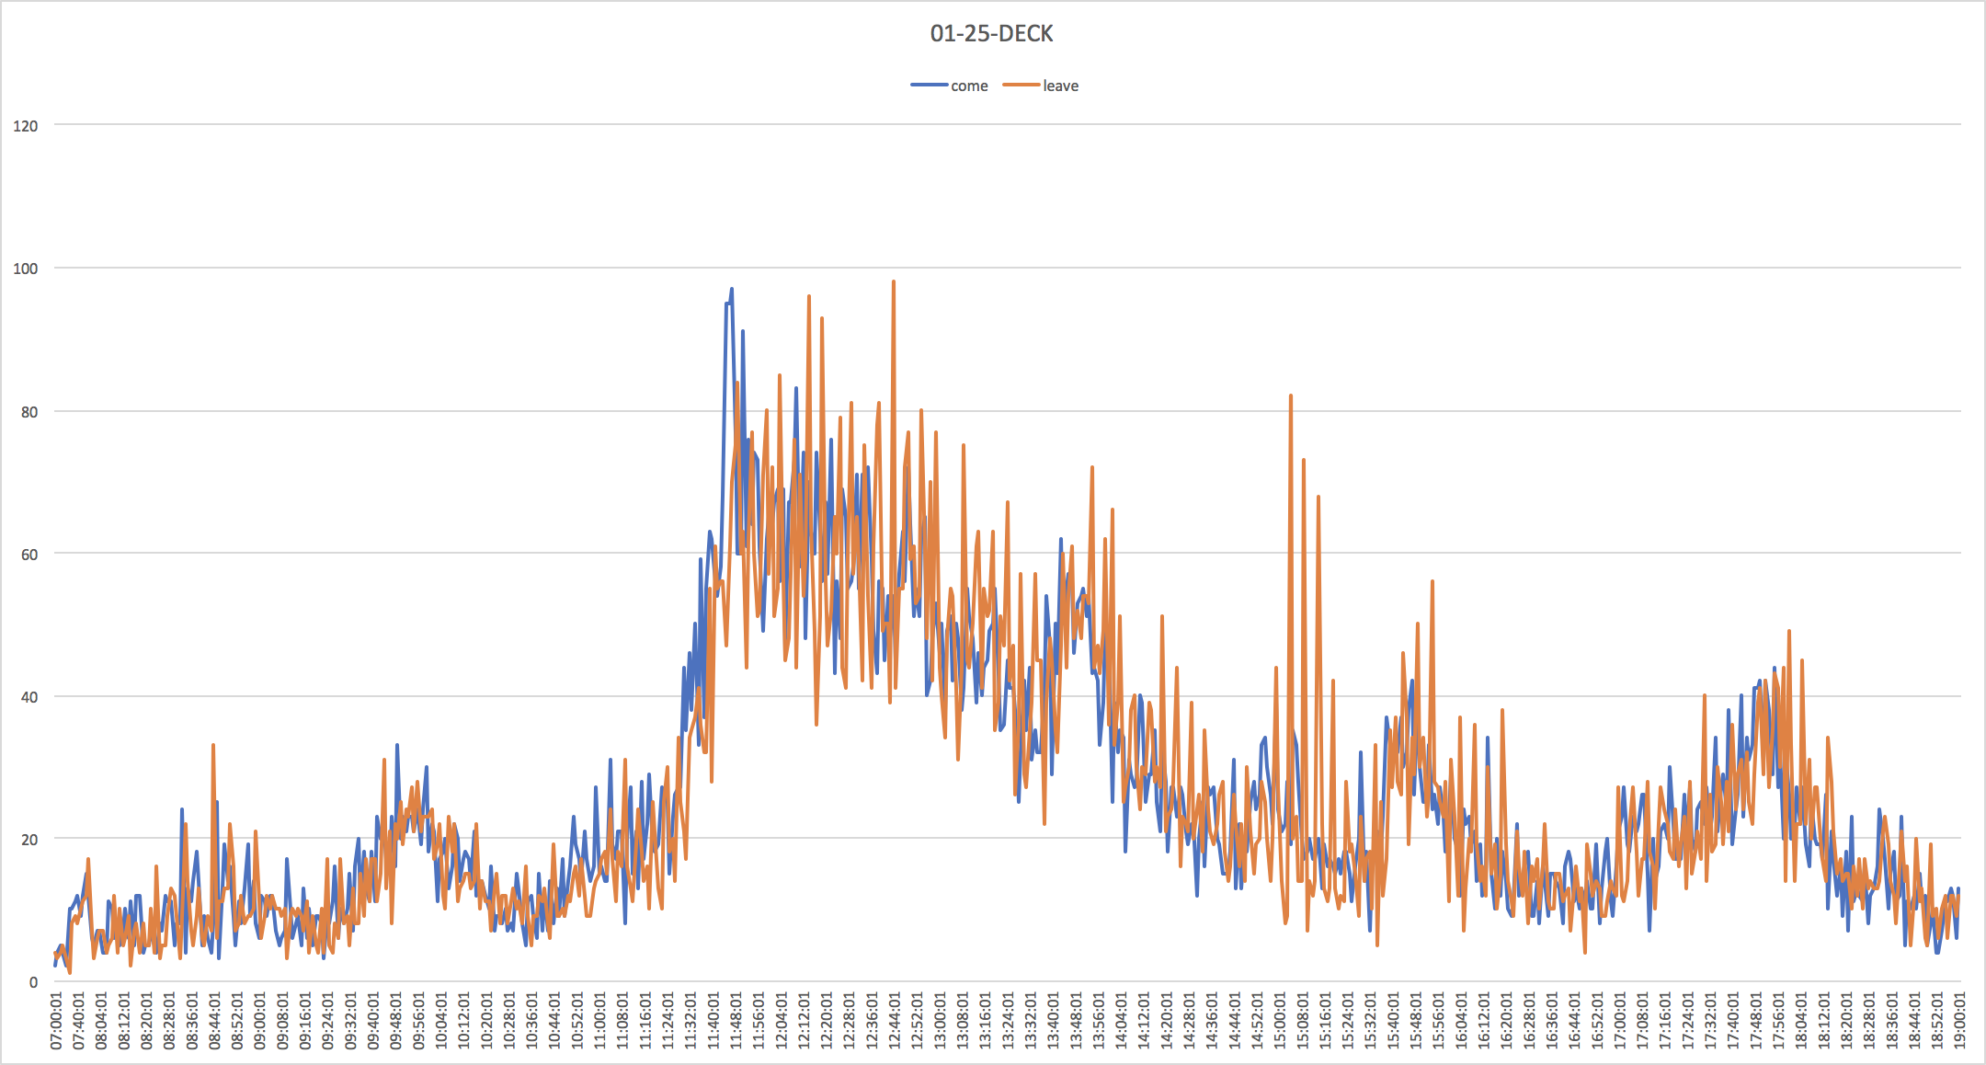
01-24

Slide 9
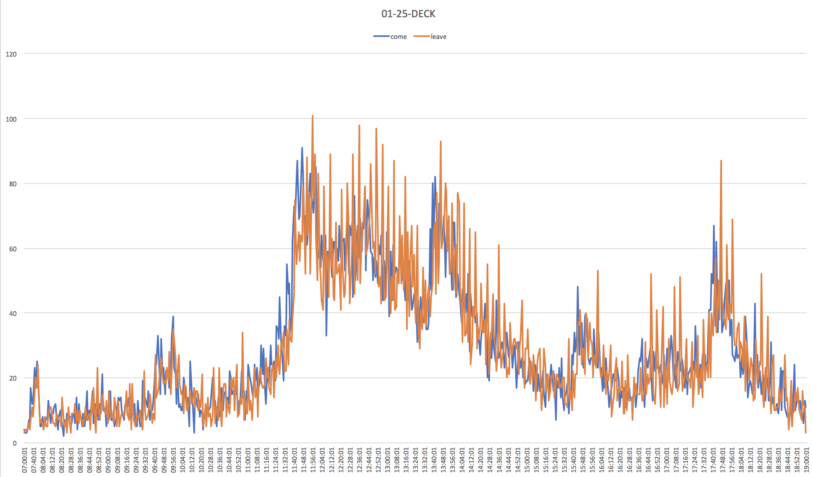
In 4 points, inflow rate increase dramatically
13.30
11.30
17.30
15.30

Slide 10
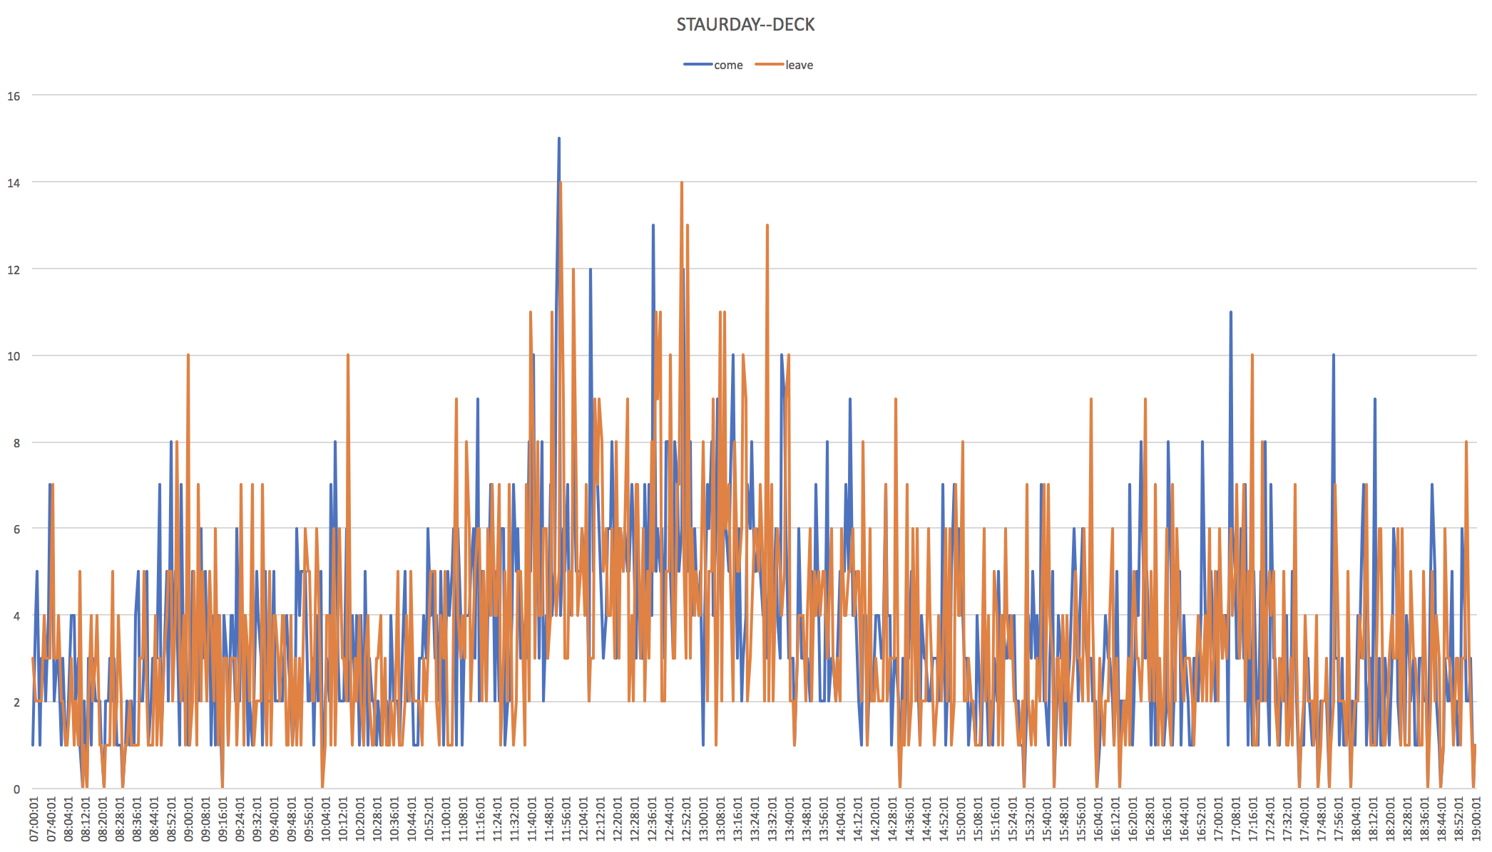
Saturday doesn‘t have this pattern.

Slide 11
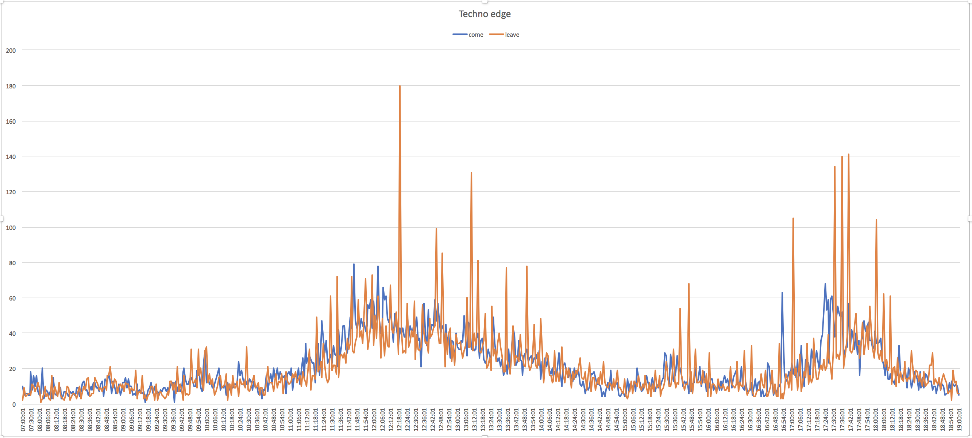
There are 2 peaks in lunch and dinner.
Lunch: 11.20---13.30
Dinner :17.20---18.30
2018-01-17 Techno edge

Slide 12
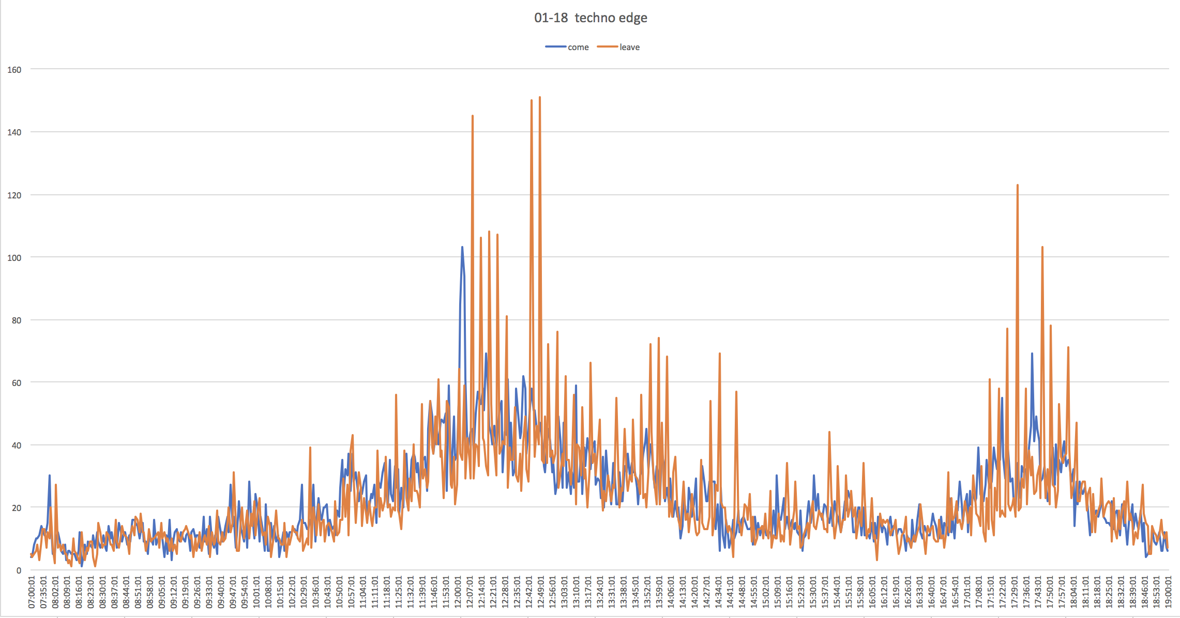

Slide 13
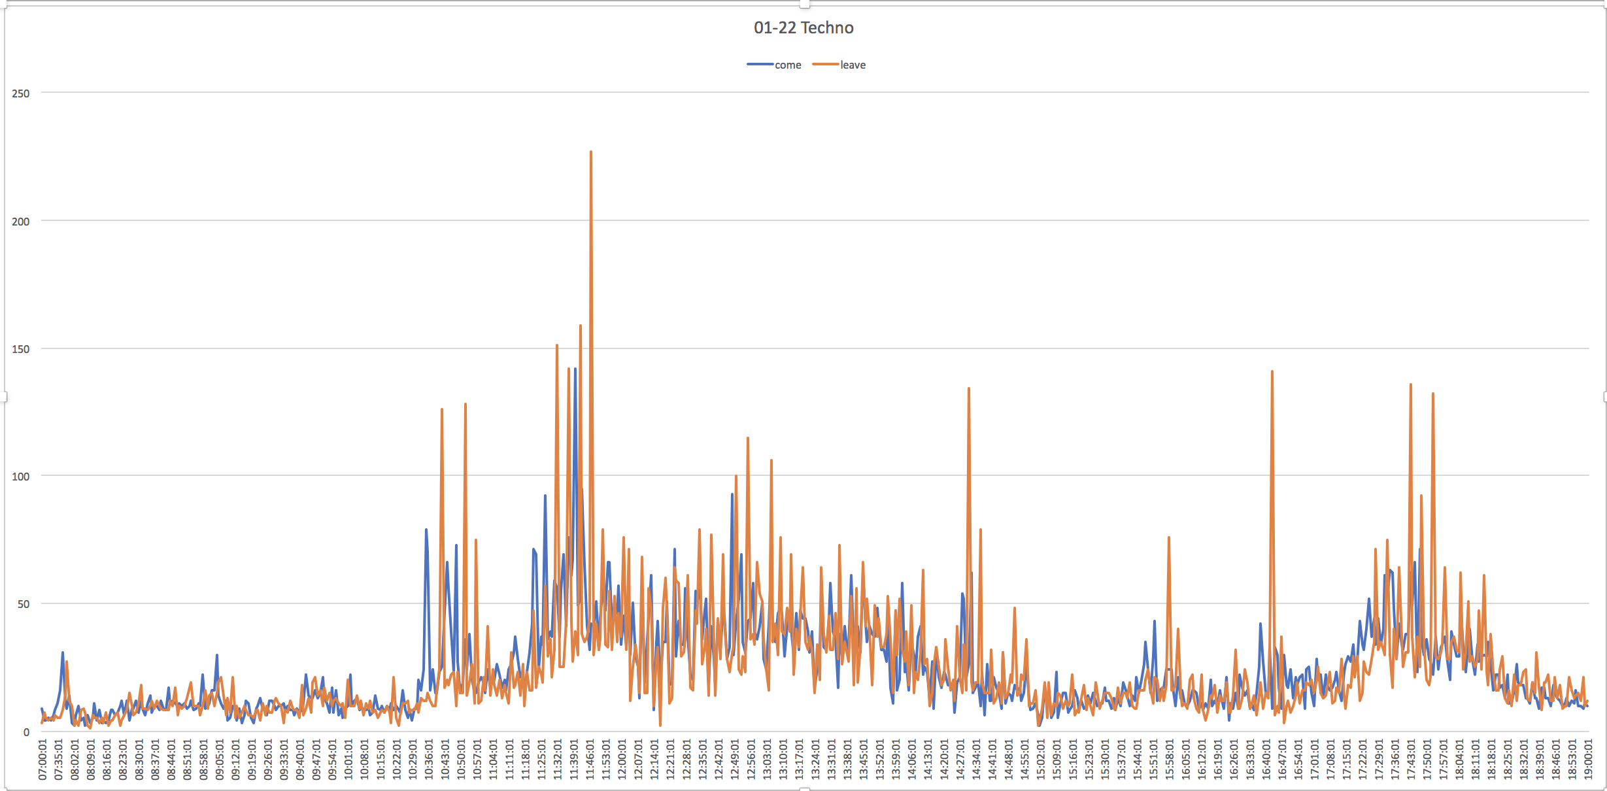

Slide 14
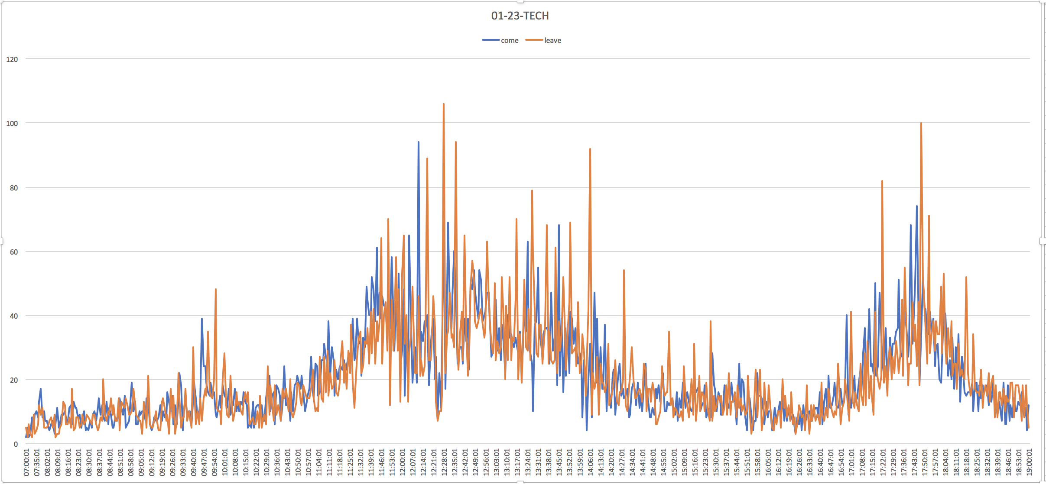
Only has 2 peaks.

Slide 15
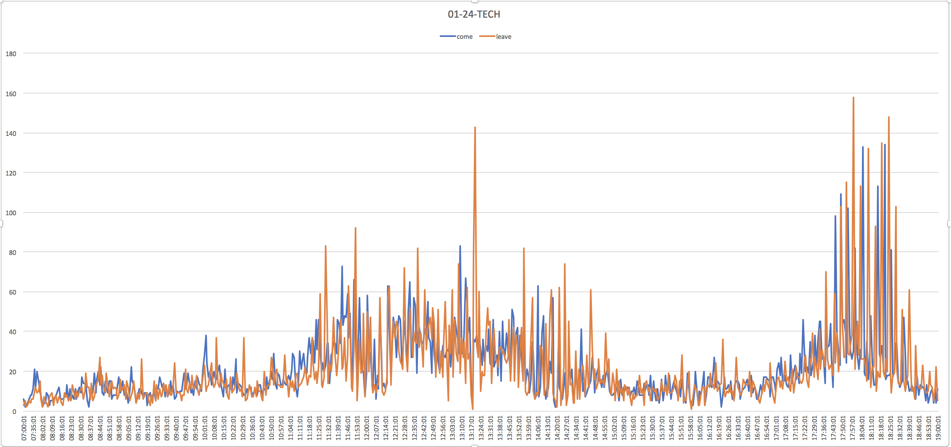

Slide 16
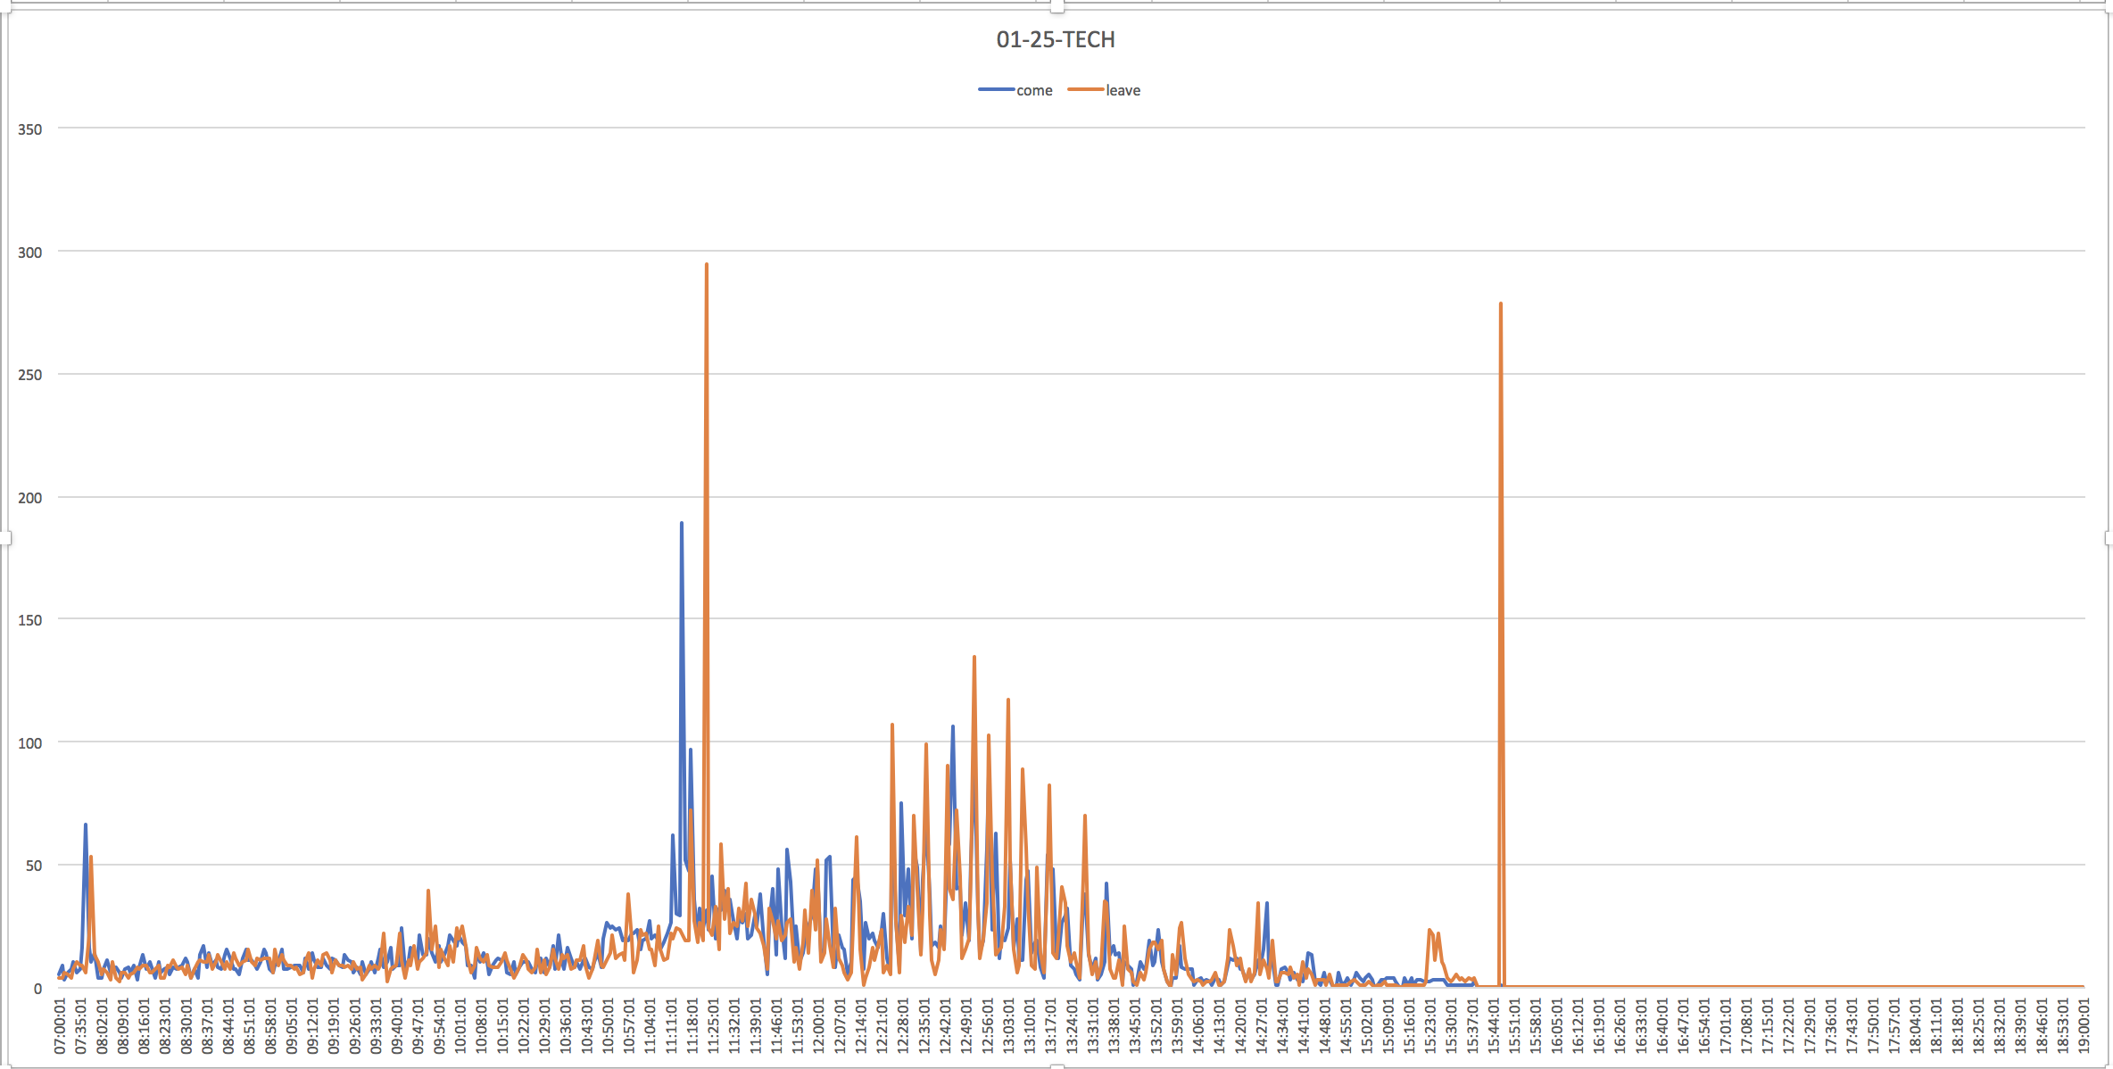
Last week, there was error in techno edge. Only had 4 days data.
error

Slide 17
What is the average meal time?
First-time will not change if the device is in this area and associated with AP. Suppose someone goes to canteen at 11.00 for lunch. After his device probing, our system can record. And the first-time is always 11.00 during his lunch. After he leaves canteen, no record. Although I don’t know how long the slot is for system to refresh the first-time. But the time between lunch and dinner is so long enough to refresh.
We can count how many first-time to calculate the stay time. For example, someone has records: 8:00 (3) 11.30(20) 17.40(15). We find the 2 most common 11.30 and 17.40. Our filter reserves 5min to 1hour(too short is pedestrian, too long maybe vendors) , time don’t meet this ranger delete.

Slide 18
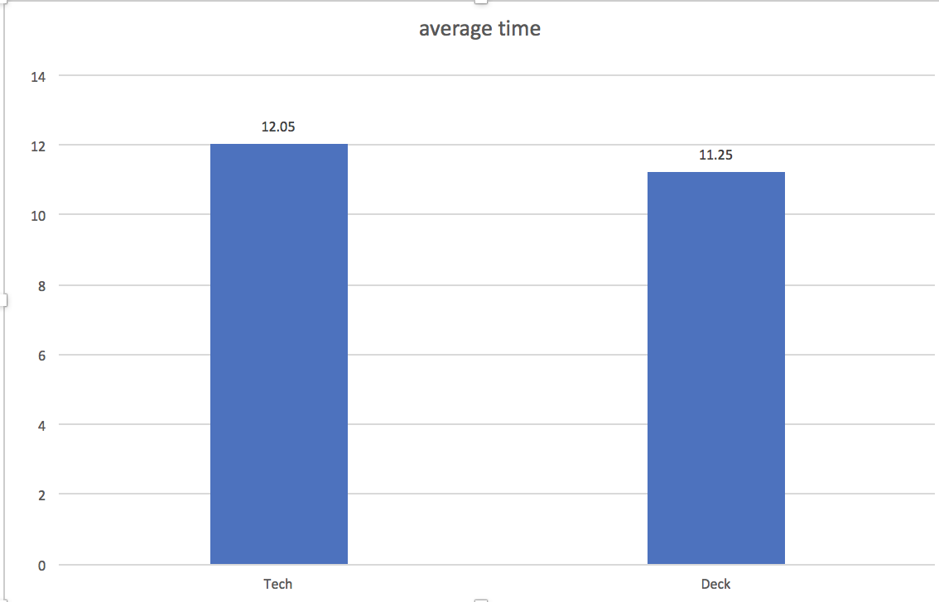
collect 3 meals
Time range: 3-60min
From 7:00--end
2018-01-17

Slide 19
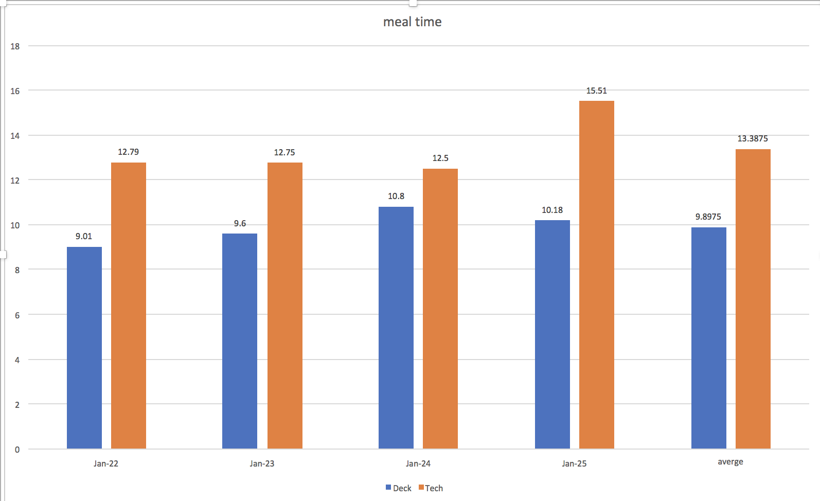
collect 3 meals
Time range: 3-60min
From 7:00--end

Slide 20
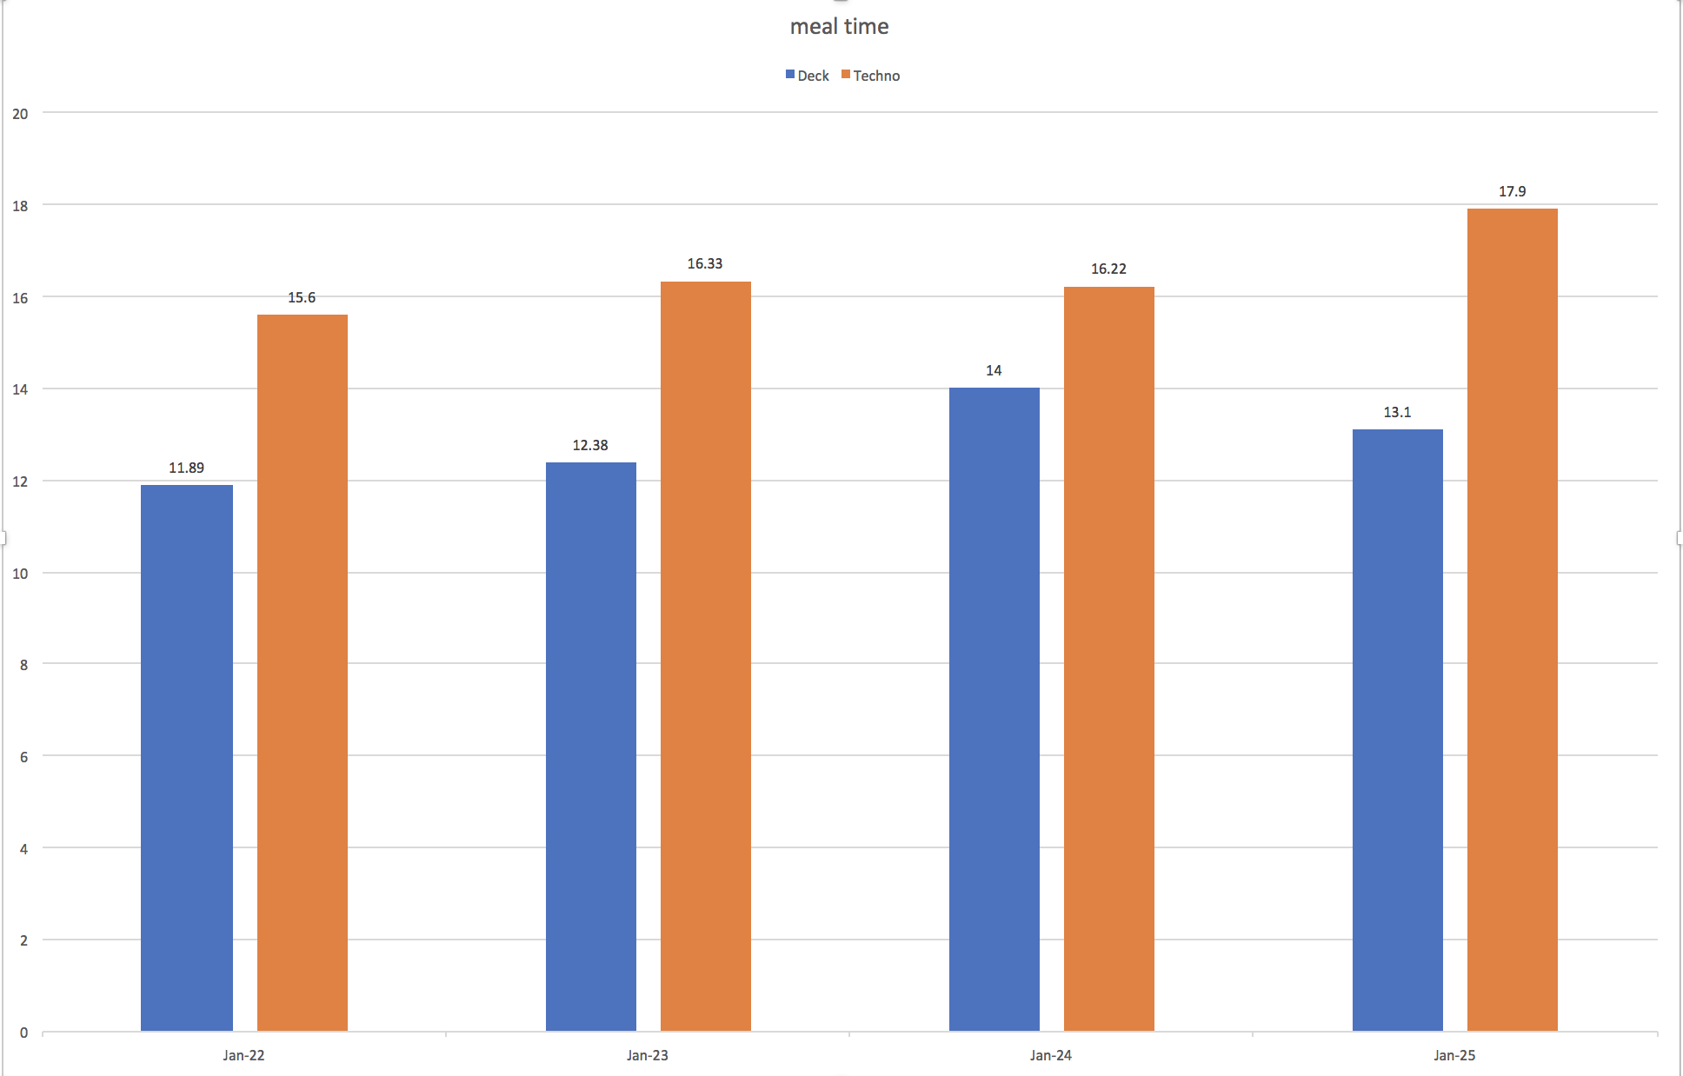
collect 2 meals
Time range: 5-60min
From 10:00—20:00

Slide 21
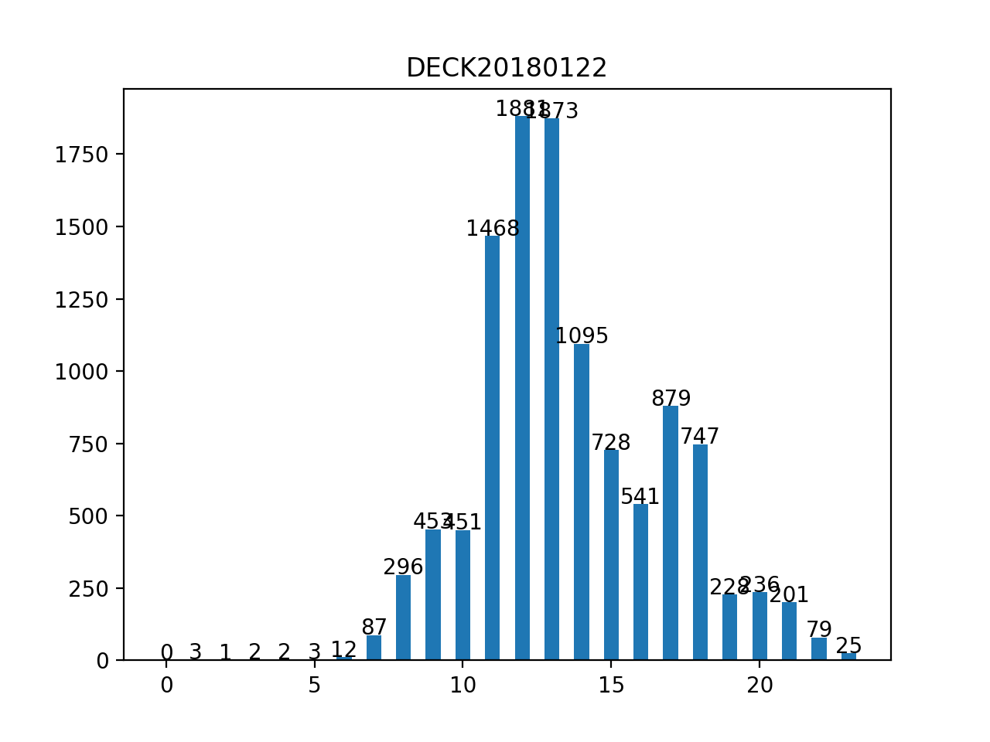
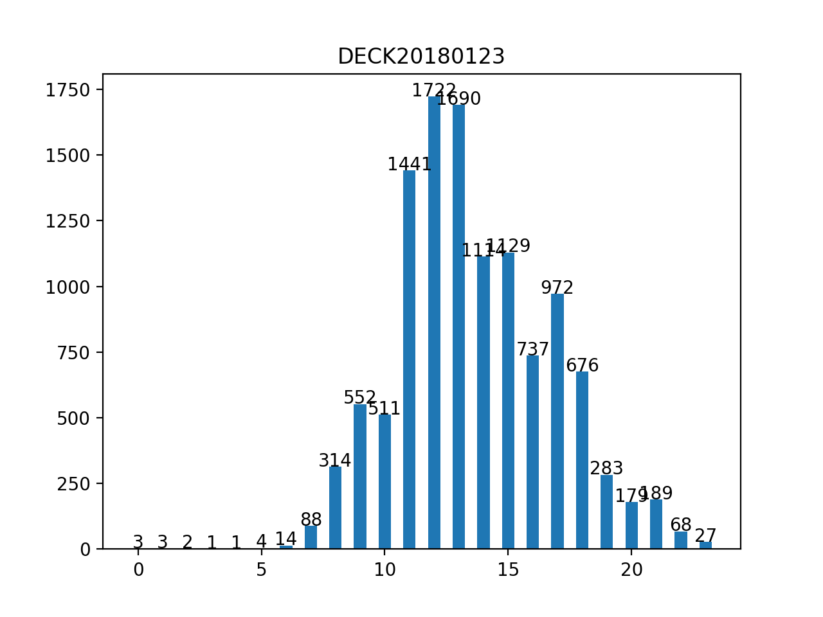
How many visitors per hour?
Meal hour lunch 11,12,13 dinner: 17,18

Slide 22
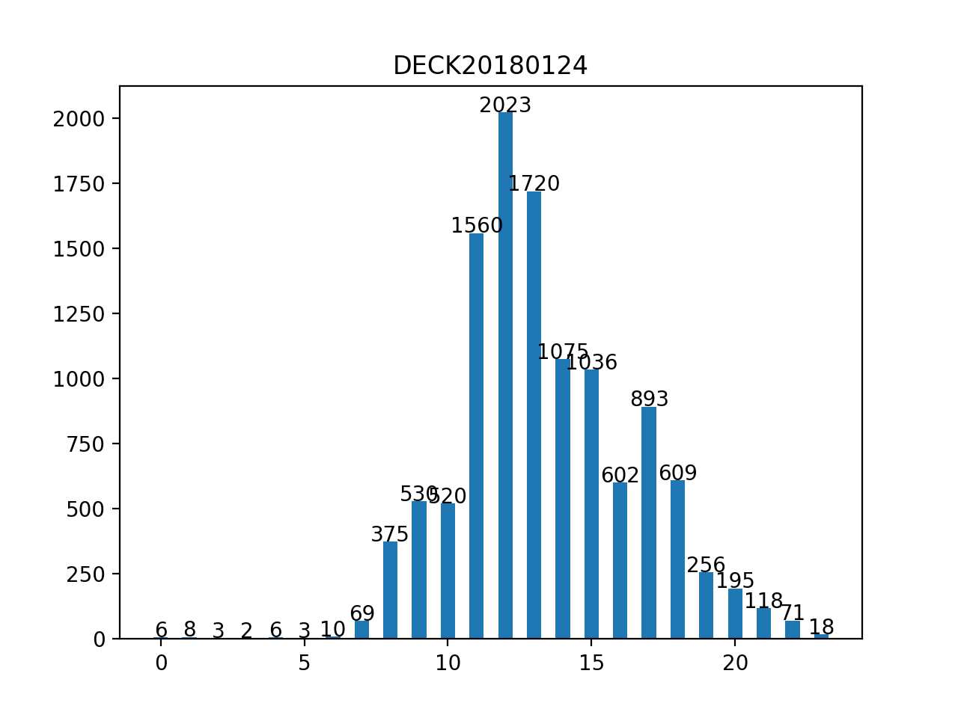
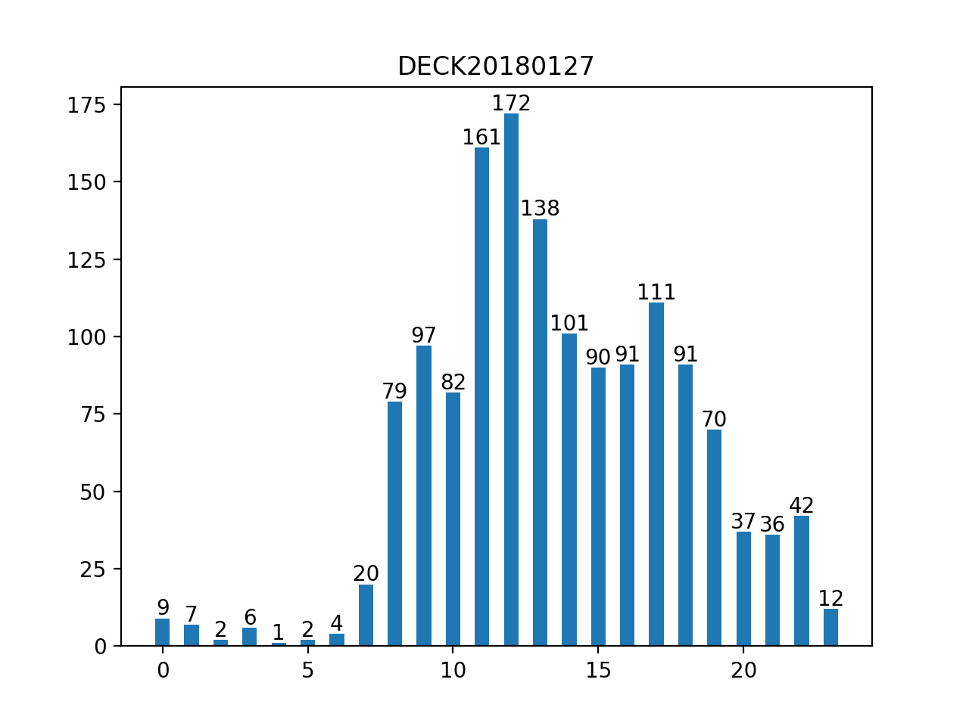

Slide 23
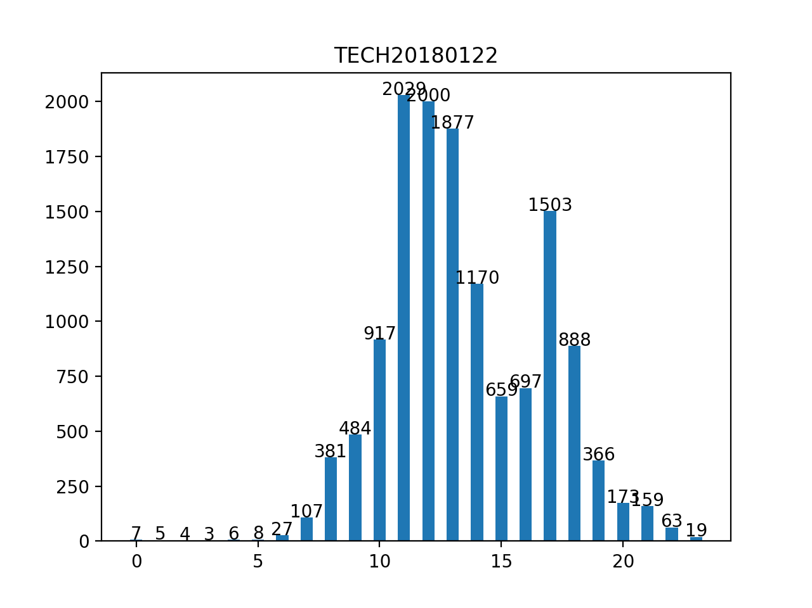
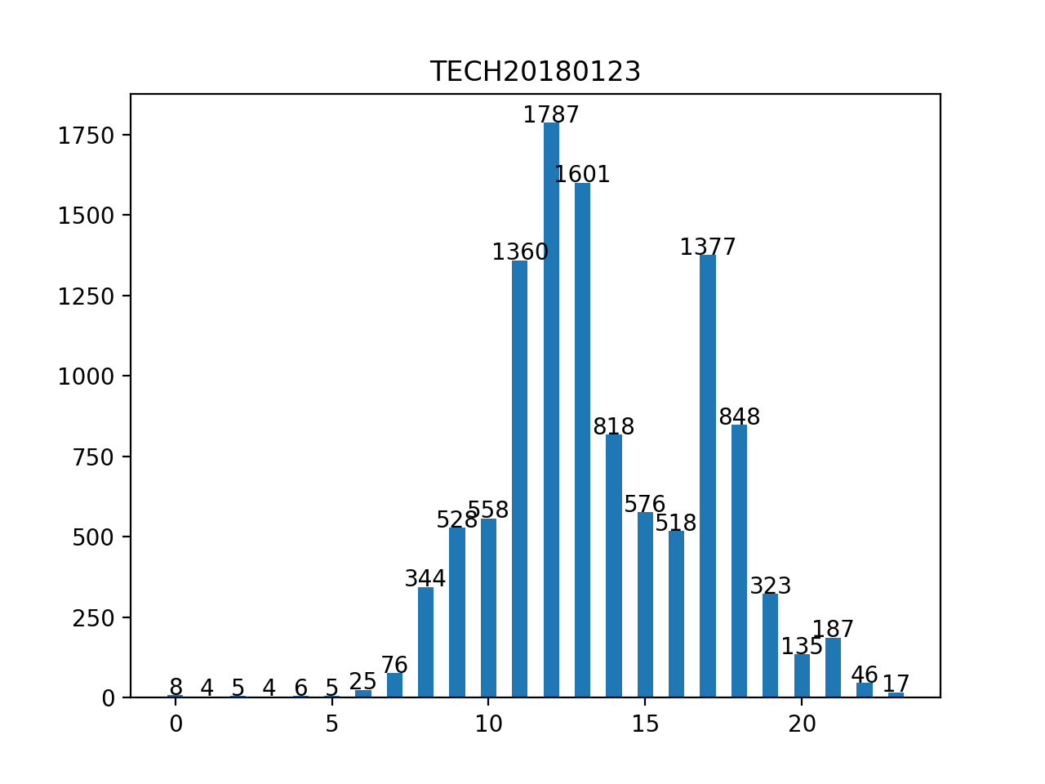
Meal hour lunch 11,12,13 dinner: 17. most master course begin at 18:00

Slide 24
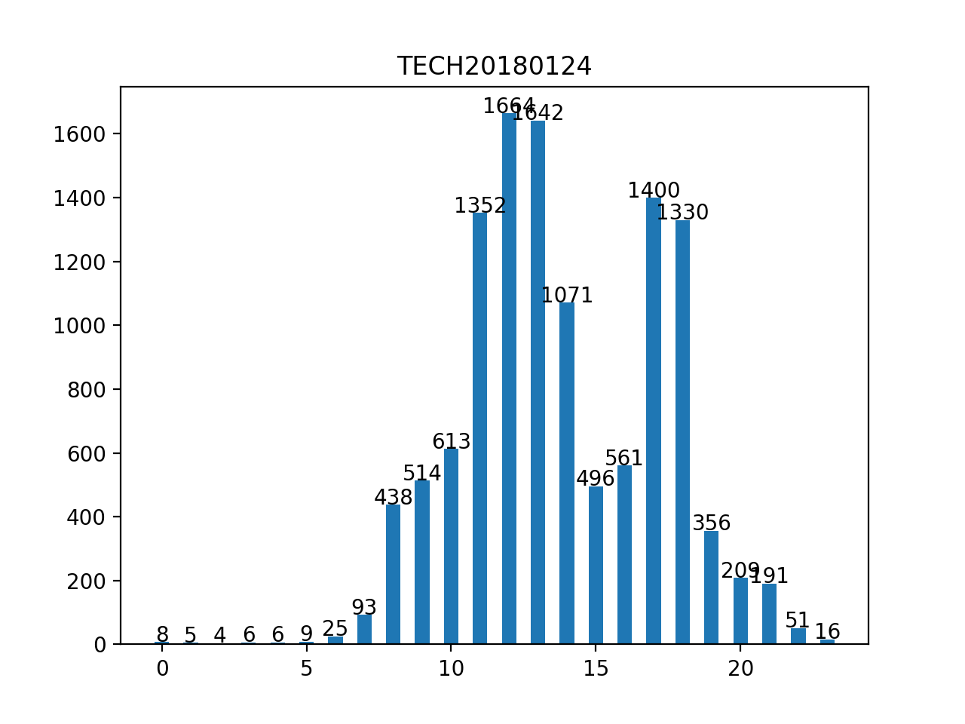
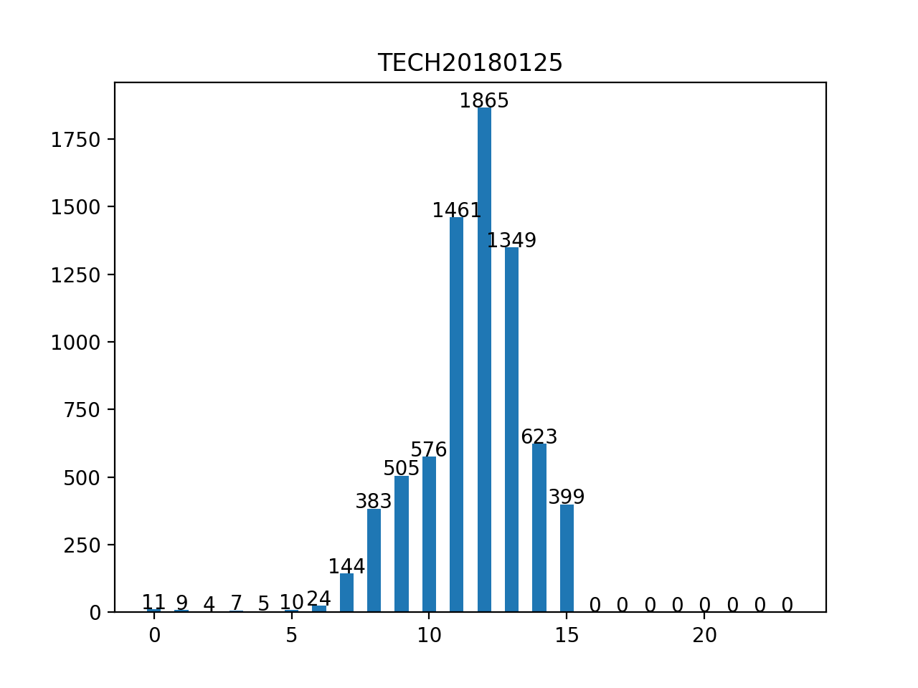

Slide 25
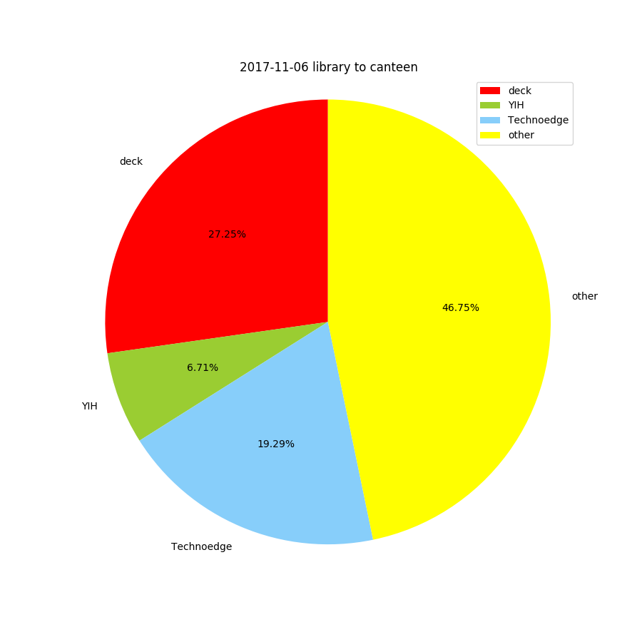
proportion

Slide 26
